Slide 1

Department of Construction Management
Kris Kego
Sem 1 2016/17
CSC 1101

Slide 2

Listening
  listening is the interpretative action taken by an individual in order to understand and potentially make meaning out of the sound waves
  Listening is the conscious processing of the auditory stimuli that have been perceived through hearing

Slide 3

Think Before You Speak
Apologize quickly when you blunder
Converse, don't compete
Time your comments
Focus on behavior - not on personality
Uncover hidden feelings
Listen for feedback

Slide 4

DO’S
Be direct, courteous and calm
Spare others your unsolicited advice
Acknowledge that what works for you may not work for others
Say main points first, then offer more details if necessary
Listen for hidden feelings
DON'T
Expect others to follow your advice or always agree with you
Suggest changes that a person can not easily make
Make personal attacks or insinuations
Be rude and pushy
Be patronizing, superior or sarcastic

Slide 5

This is communication through sending and receiving wordless cues
It includes the use of cues such as
  body language (kinesics)
  distance (proxemics)
  physical environments/appearance,
  Of voice (paralanguage)
  Of touch (haptics)
  Of time (chronemics)
  Of sight (oculesics)

Slide 6

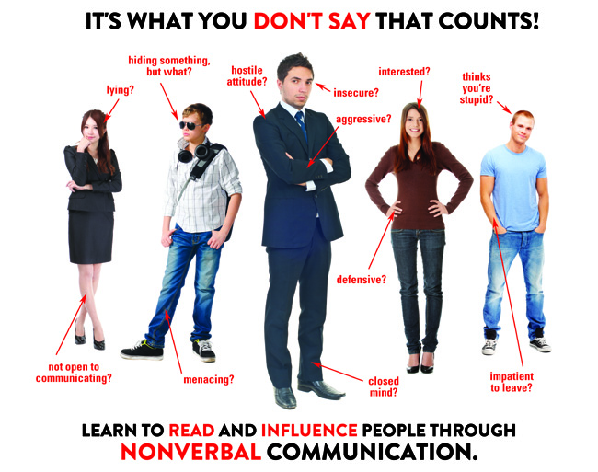

Slide 7

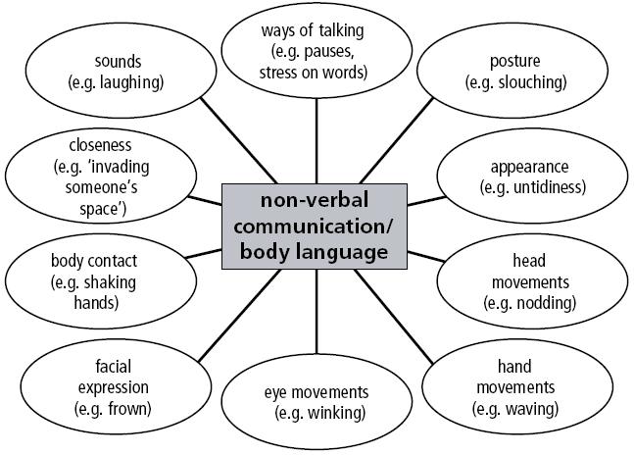

Slide 8

Only a small percentage of the brain processes verbal communication
As infants, nonverbal communication is learned from social-emotional communication, making the face rather than words the major organ of communication
As children become verbal communicators, they begin to look at facial expressions, vocal tones, and other nonverbal elements more subconsciously

Slide 9
Nonverbal communication represents two-thirds of all communication
Nonverbal communication can portray a message both vocally and with the correct body signals
Body signals comprise physical features, conscious and unconscious gestures and signals, and the mediation of personal space
Nonverbal communication strengthens a first impression in common situations like attracting a partner or in a business interview: impressions are on average formed within the first four seconds of contact

Slide 10

It takes just one-tenth of a second for someone to judge and make their first impression
A first impression is a lasting non-verbal communicator
The way a person portrays themselves on the first encounter is non-verbal statement to the observer
“First impressions are lasting impressions.”
There can be positive and negative impressions

Slide 11

First encounters or interactions with another person strongly affect a person's perception
When meeting for the first time; they are focused on the entire environment around them, meaning the other person uses all five senses in the interaction: 83% sight, 11% hearing, 3% smell, 2% touch and 1% taste

Slide 12
Body language means
  How you stand
    Stand straight, Stand on both legs.
  How you move
    Don't fidget, scratch, jiggle your legs
  How you appear to people
    Look energetic
  How you look at people
    Look relaxed
  How you sound
    Breathe slowly, Use humor-- enjoy yourself

Slide 13

The term "kinesics" was first used (in 1952) by Ray Birdwhistell, an anthropologist who wished to study how people communicate through posture, gesture, stance, and movement
American looks are short enough just to see if there is recognition of the other person, Arabs look at each other in the eye intensely, and many Africans avert the gaze as a sign of respect to superiors

Slide 14

There are many different types of body positioning to portray certain postures, including slouching, towering, legs spread, jaw thrust, shoulders forward, and arm crossing
The posture or bodily stance exhibited by individuals communicates a variety of messages whether good or bad
Posture can be used to determine a participant's degree of attention or involvement, the difference in status between communicators, and the level of fondness a person has for the other communicator, depending on body "openness

Slide 15

Clothing is one of the most common forms of non-verbal communication.
The types of clothing that an individual wears conveys nonverbal cues about his or her personality, background and financial status, and how others will respond to them
An individual's clothing style can demonstrate their culture, mood, level of confidence, interests, age, authority, and values/beliefs
Similarly, clothing can communicate what nationality a person or group is

Slide 16

Gestures may be made with the hands, arms or body, and also include movements of the head, face and eyes, such as winking, nodding, or rolling one's eyes
These are conventional, culture-specific gestures that can be used as replacement for words, such as the hand wave used in western cultures for "hello" and "goodbye.“
Gestures can also be categorized as either speech independent or speech related

Slide 17

According to Edward T Hall, the amount of space we maintain between ourselves and the persons with whom we are communicating shows the importance of the science of proximics
  Intimate distance (closeness & trust)
  Personal distance (at arm's length)
  Social distance (classroom relationships)
  Public distance (not desirable or possible )

Slide 18

Eye contact is the instance when two people look at each other's eyes at the same time; it is the primary nonverbal way of indicating engagement, interest, attention and involvement
Studies have found that people use their eyes to indicate interest
This includes frequently recognized actions of winking and movements of the eyebrows
When an individual is interested however, the pupils will dilate

Slide 19

Haptics is the study of touching as nonverbal communication, and haptic communication refers to how people and other animals communicate via touching.
Touches among humans that can be defined as communication include handshakes, holding hands, kissing (cheek, lips, hand), back slapping, high fives, a pat on the shoulder, and brushing an arm

Slide 20

Express emotions
Express interpersonal attitudes
To accompany speech in managing the cues of interaction between speakers and listeners
Self-presentation of one's personality
Rituals (greetings)

Slide 21

Conflicting
Conflicting Verbal and nonverbal messages within the same interaction can sometimes send opposing or conflicting messages
A person verbally expressing a statement of truth while simultaneously fidgeting or avoiding eye contact may convey a mixed message to the receiver in the interaction

Slide 22
Complementing
Accurate interpretation of messages is made easier when nonverbal and verbal communication complement each other
Nonverbal cues can be used to elaborate on verbal messages to reinforce the information sent when trying to achieve communicative goals

Slide 23
Substituting
Nonverbal behavior is sometimes used as the sole channel for communication of a message
People learn to identify facial expressions, body movements, and body positioning as corresponding with specific feelings and intentions

Slide 24
Structure versus non-structure
Verbal communication is a highly structured form of communication with set rules of grammar
The rules of verbal communication help to understand and make sense of what other people are saying
On the other hand nonverbal communication has no formal structure when it comes to communicating.
Nonverbal communication occurs without even thinking about it
The same behavior can mean different things such as crying of sadness or of joy

Slide 25
Linguistic versus non-linguistic
There are only a few assigned symbols in the system of nonverbal communication
Nodding the head is one symbol that indicates agreement in some cultures but in others it means disagreement
On the other hand, verbal communication has a system of symbols that have specific meanings to them

Slide 26
Continuous and discontinuous
Verbal communication is based on discontinuous units whereas nonverbal communication is continuous
Communicating nonverbally cannot be stopped unless one would leave the room
For example, after a heated debate there are no other words being said but there are still angry faces and cold stares being distributed

Slide 27
Learned versus innate
Learned non-verbal cues require a community or culture for their reinforcement, e.g. table manners are not innate capabilities upon birth
Dress code is a non-verbal cue that must be established by society.
Hand symbols, whose interpretation can vary from culture to culture, are not innate nonverbal cues
Innate non-verbal cues are "built-in" features of human behavior
For example, smiling, crying, and laughing do not require teaching

Slide 28

Andersen, Peter. (2007). Nonverbal Communication: Forms and Functions (2nd ed.)
Andersen, Peter. (2004). The Complete Idiot's Guide to Body Language.
Argyle, Michael. (1988). Bodily Communication (2nd ed.) Madison:
Brehove, Aaron. (2011). Knack Body Language: Techniques on Interpreting Nonverbal Cues in the World and Workplace.
Bull, P. E. (1987). Posture and Gesture. Oxford:
Burgoon, J. K, Guerrero, L. K., & Floyd, K. (2011), Nonverbal communication, Boston: Allyn & Bacon.
Floyd, K., Guerrero, L. K. (2006), Nonverbal communication in close relationship
Freitas-Magalhães, A. (2006). The Psychology of Human Smile.

